Slide 1

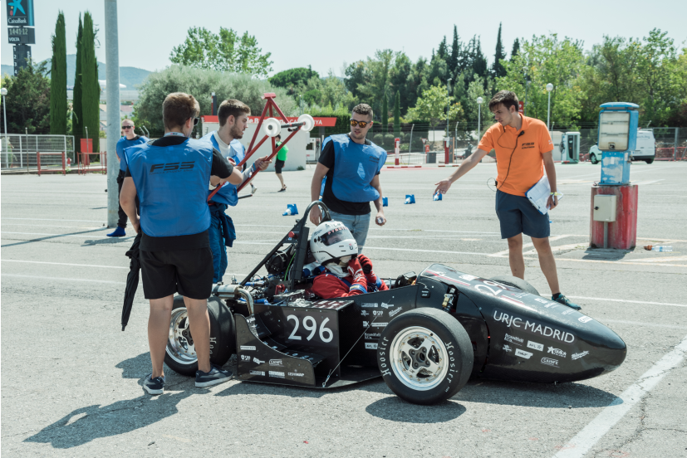
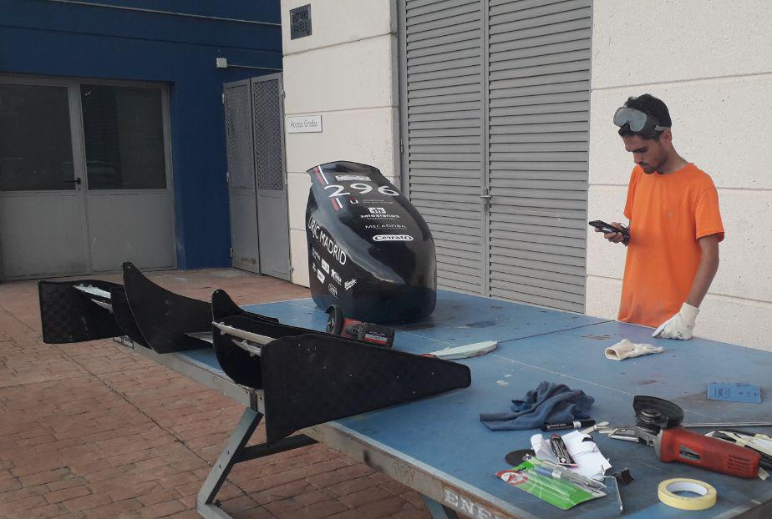

DR – Design Release
20/05/2022
Project cost estimation: 291€
Wheel Sensorization
Division chief: Rubén Jiménez Mejías
Project Manager: David Jiménez Urbano

Slide 2
Wheel Sensorization
Index
DR – Design Release
Final Design
Bill of Materials (BOM)
Validation Plan: Results
Market offers
Target verification
Updated documents

Slide 3
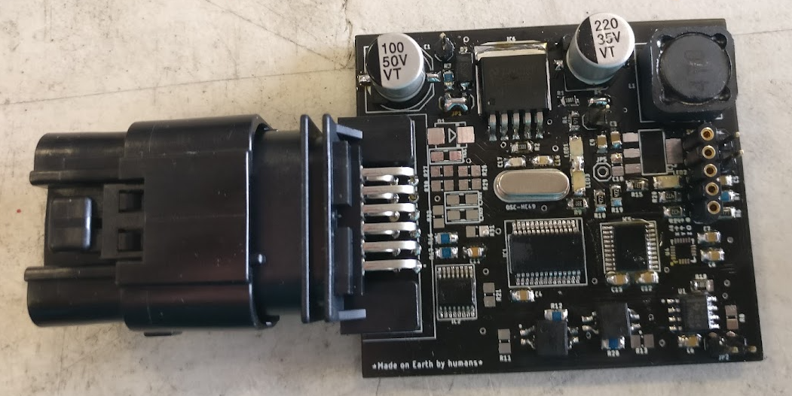
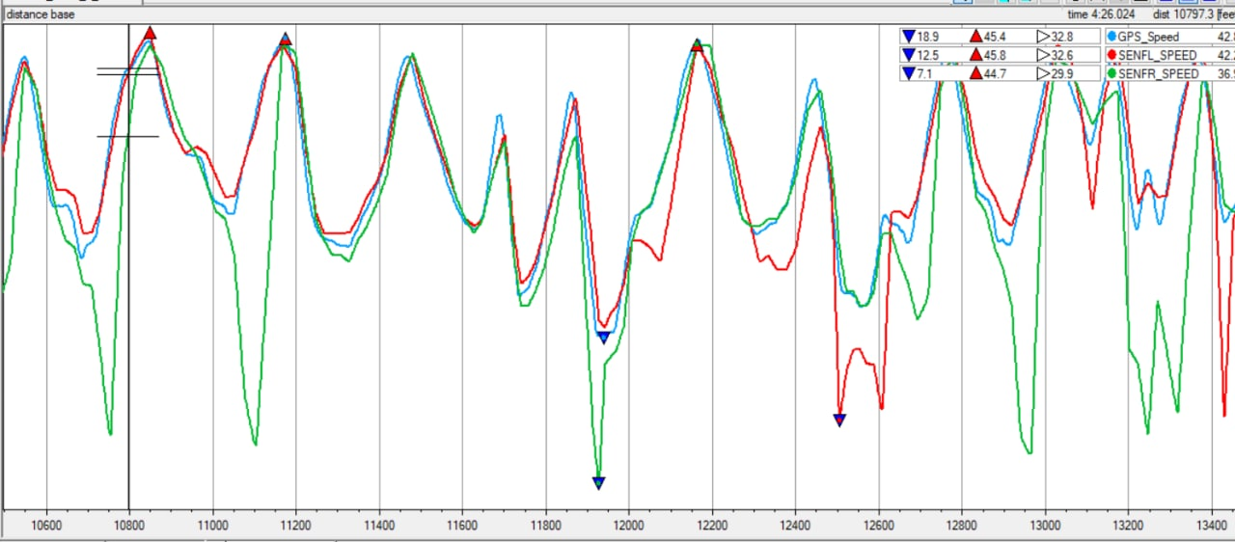
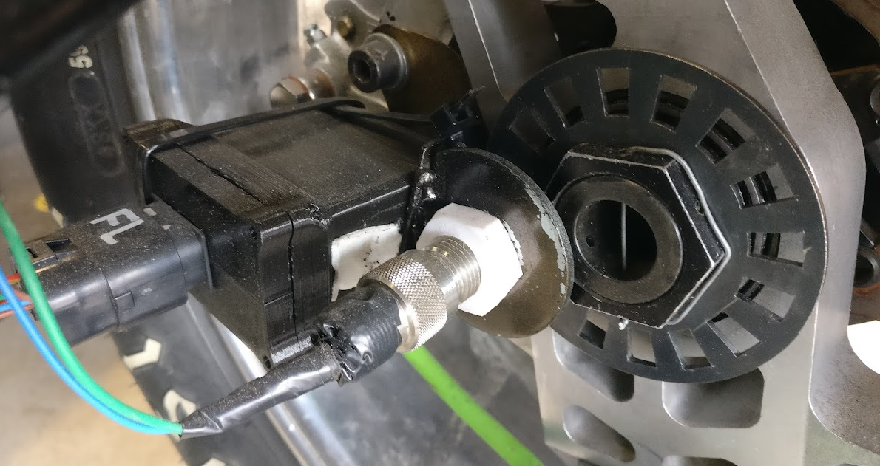
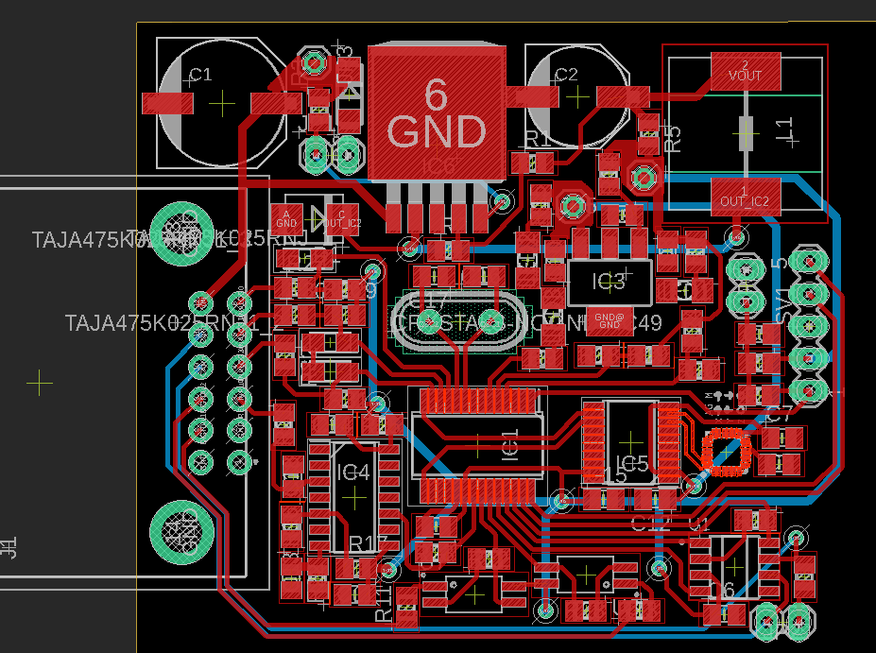
Wheel Sensorization
Final Design
DR – Design Release
The objective was to create a reliable and light system that registers the speed of the wheels, linear and angular acceleration in 3 axes, and extra signals that we might have, and transmits them to the CAN bus.

Slide 4
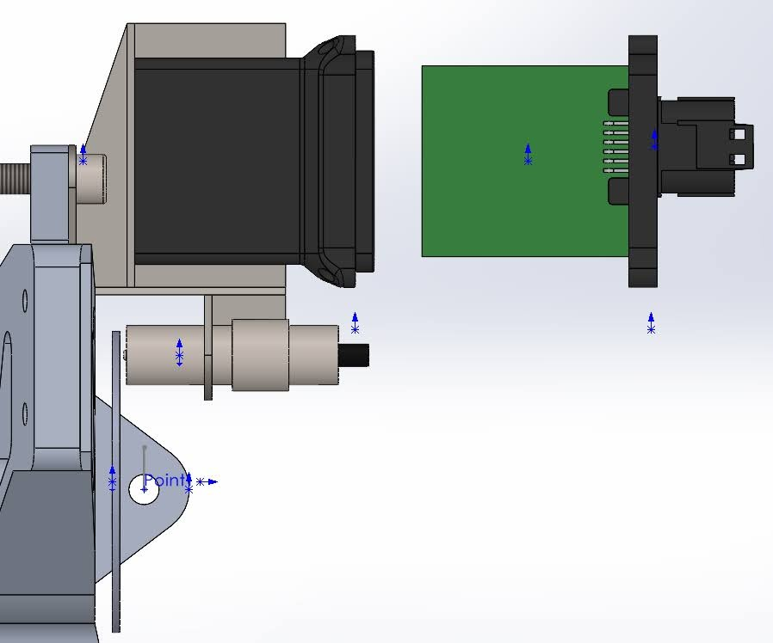
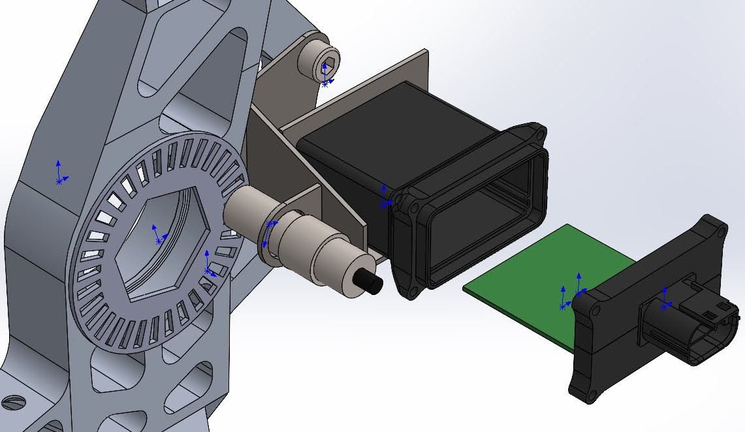
Wheel Sensorization
Final Design
DR – Design Release
A custom PCB was used, enclosed in a plastic box with a waterproof connector, supported by a steel platen to the brake caliper screws. The wheel speed sensor was attached to the same platen, and the phonic wheel to the wheel hub nut.

Slide 5
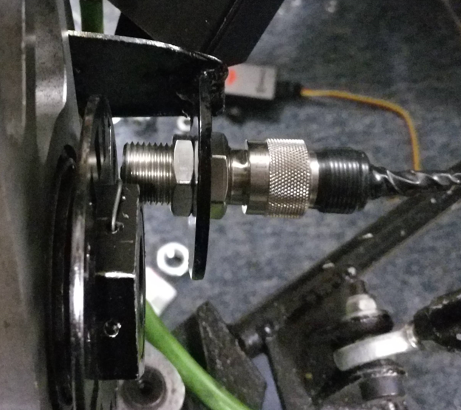
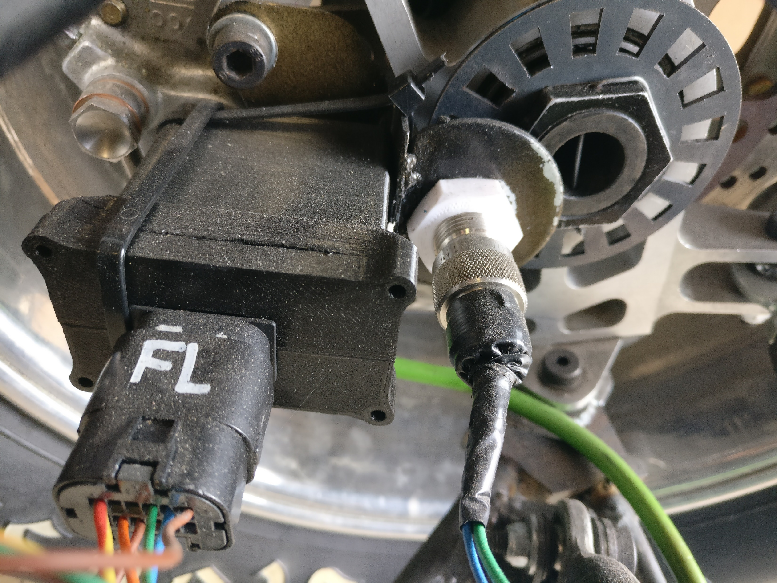
Wheel Sensorization
Final Design
DR – Design Release
The speed of the wheels is read with a reluctor sensor and a phonic wheel, which produces a variation in the magnetic flux at the tip of the sensor, resulting in a voltage produced, similar to the working principle of an electric generator.
We will only have sensors in the front wheels, because the assembly in the back wheels would be much more complicated, and it doesn’t seem necessary. If we find otherwise, we will also do it in the back wheels.

Slide 6
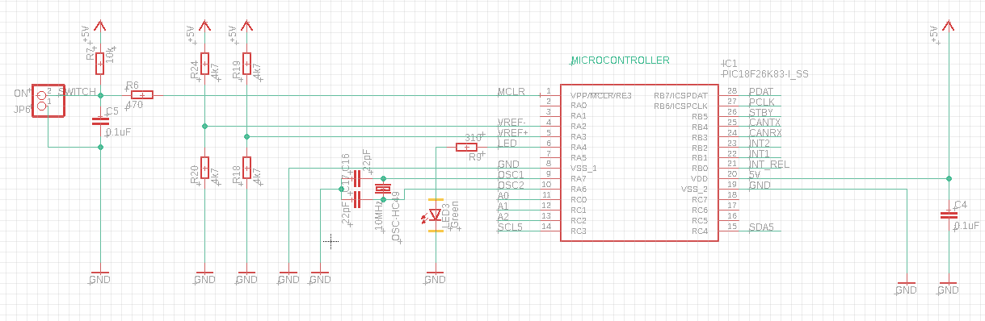
Wheel Sensorization
Final Design
DR – Design Release
The PCB uses a PIC microcontroller to count the signals from the reluctor sensor and process all the communications with the integrated IMU and multipurpose analog and digital signals, and manages the CAN communications with the rest of the vehicle.

Slide 7
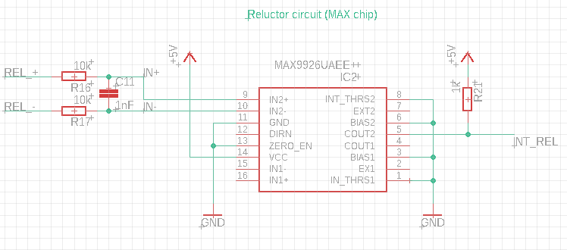
Wheel Sensorization
Final Design
DR – Design Release
Circuit diagrams:

Slide 8
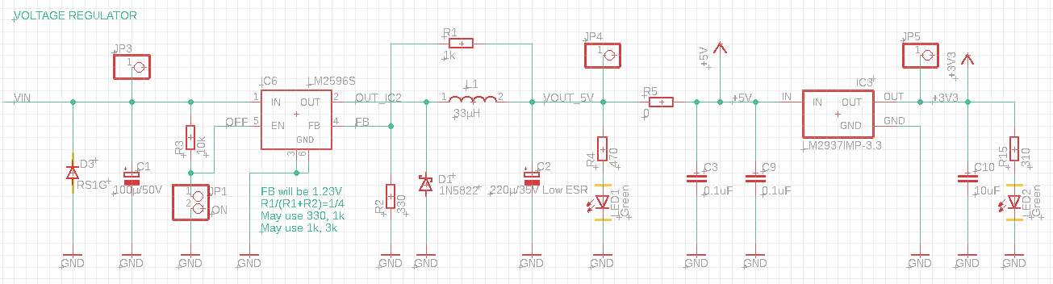
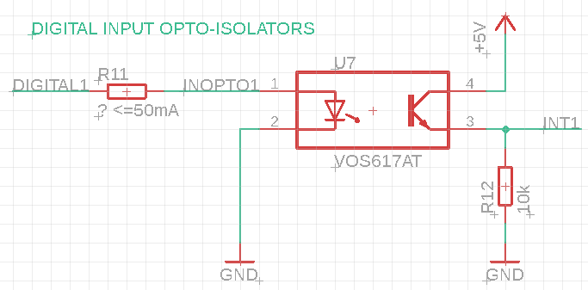
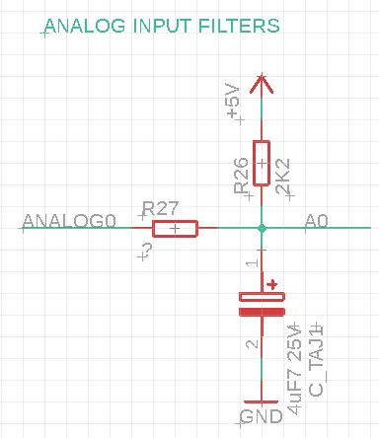
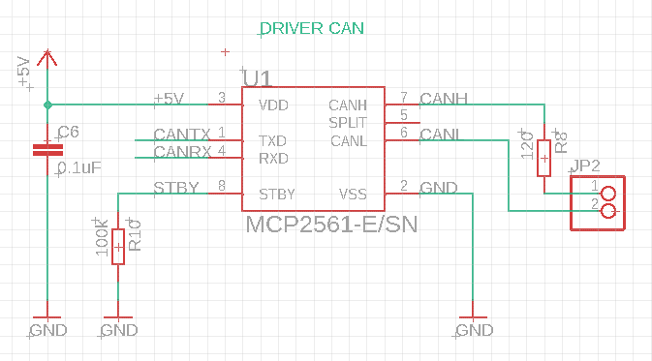
Wheel Sensorization
Final Design
DR – Design Release
Circuit diagrams:

Slide 9
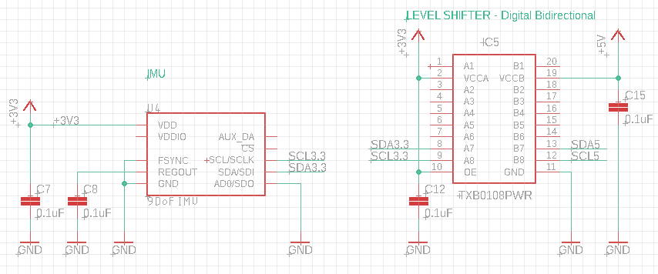
Wheel Sensorization
Final Design
DR – Design Release
Circuit diagrams:

Slide 10
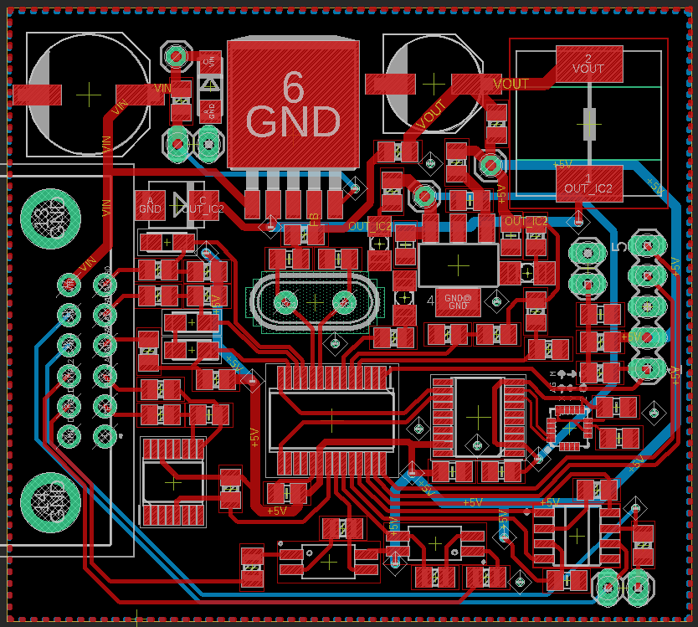
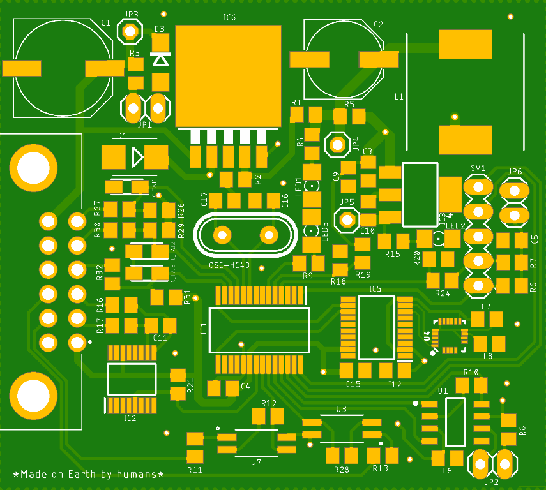
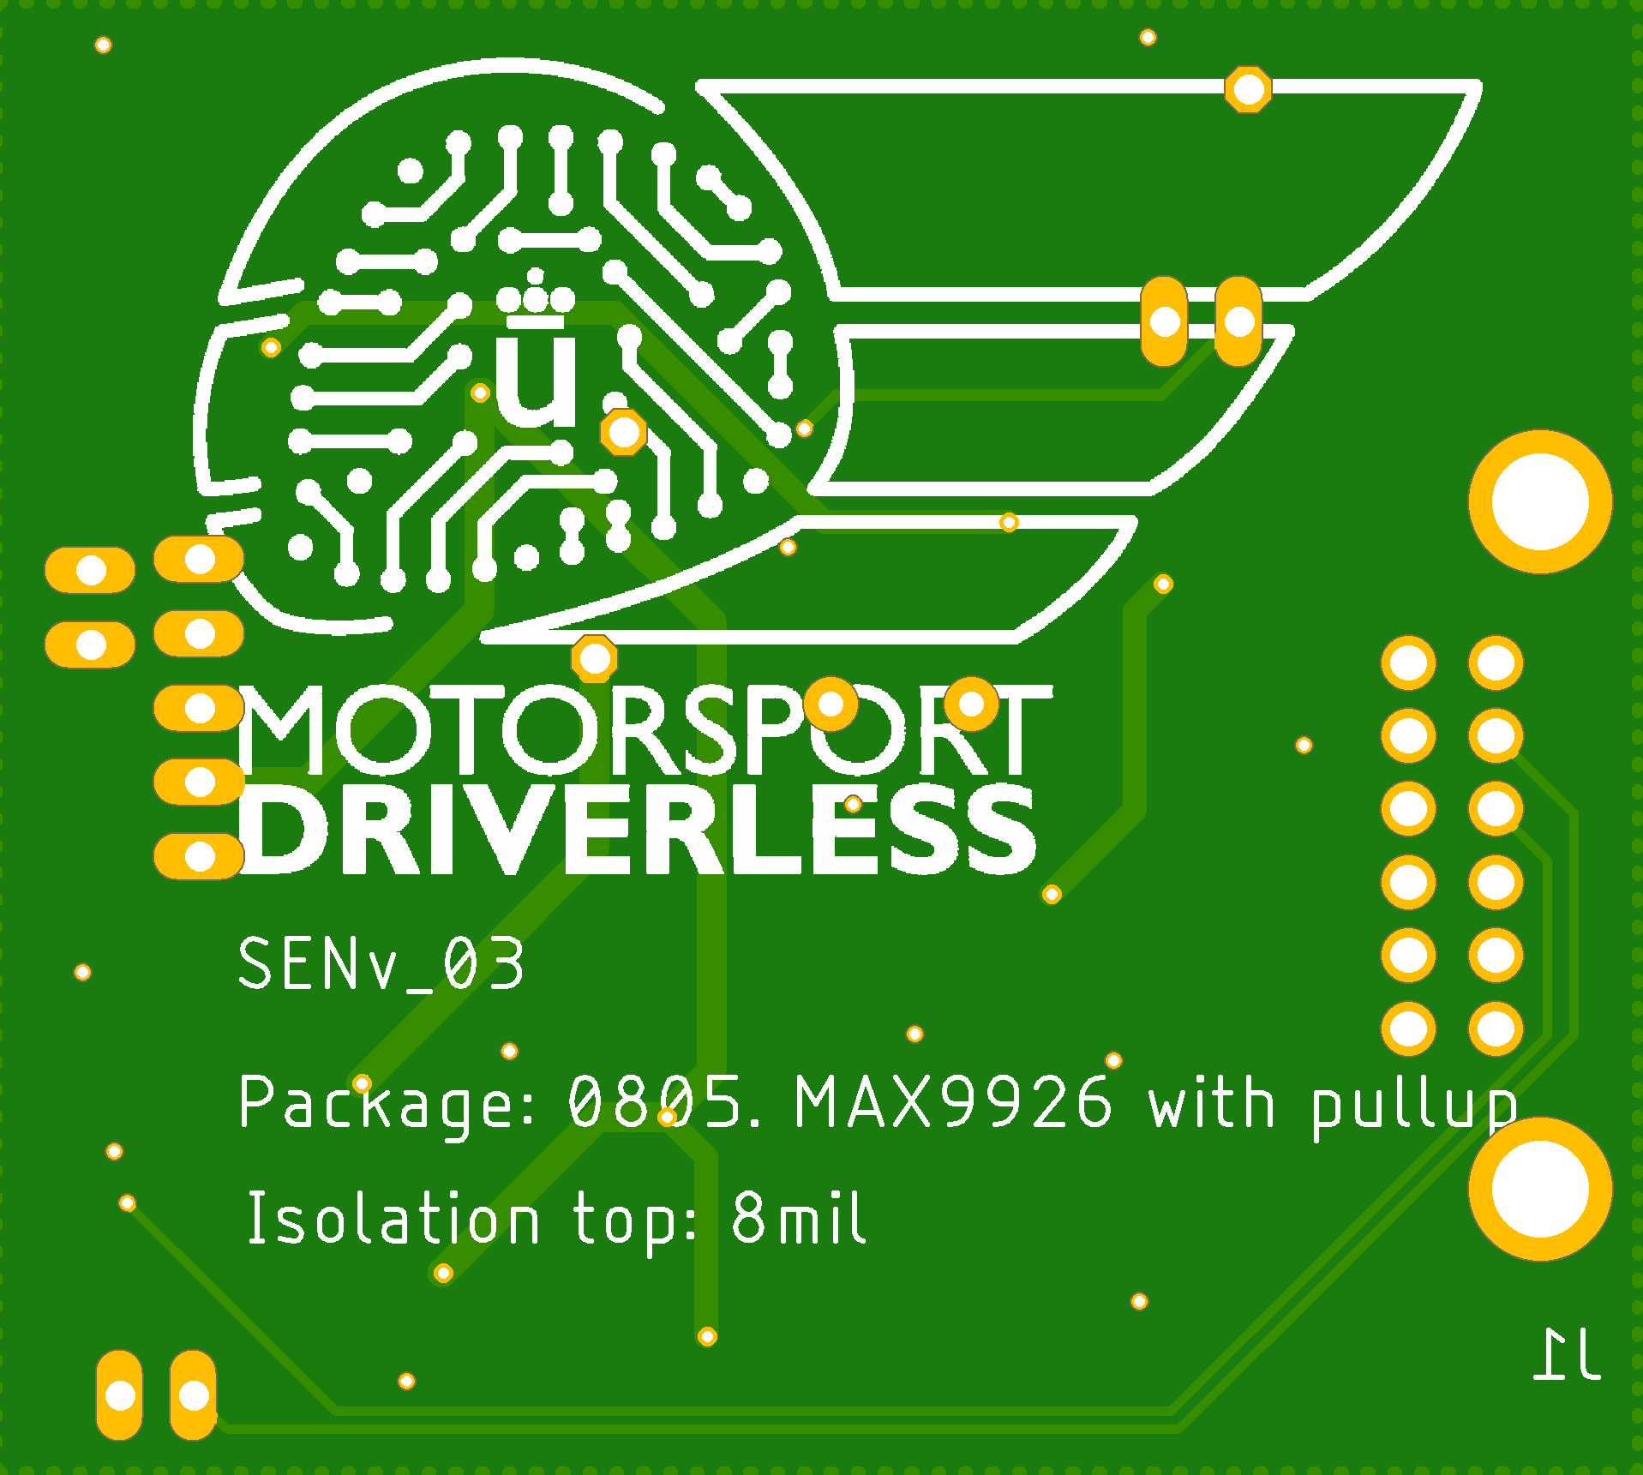
Wheel Sensorization
Final Design
DR – Design Release

Slide 11
Wheel Sensorization
Final Design
DR – Design Release
The data obtained from this board has allowed us to confirm that, during a hard turn, the front inner tires of the car often lose traction. This data has helped improve the design of the next car, UM06, in addition to its main objective of giving wheel speed information to the autonomous system.

Slide 12
Wheel Sensorization
Final Design
DR – Design Release
Weight:
Item | Weight (grams)
Phonic wheel | 43
Wheel Speed Sensor | 70
3d printed box | 30
PCB + components + cabling | 40
Steel platen | 170
TOTAL weight of assembly | 353

Slide 13
Wheel Sensorization
Bill of Materials (BOM)
DR – Design Release
Item | Quantity | Description | Cost
Electronic Components | Set for 4 PCBs | Mouser | ~70€
Wheel Speed Sensor | 4 | RS | 200€
Phonic wheels* | 4 | Laser cut steel | ~0
Box with lid | 4 | 3d printed PLA, 30g at 30€/kg | 1€
Waterproof connector | 4 | Mouser | 15€
PCB | 4 | JLCPCB | 5€
Steel platen | 4 | Built in workshop | ~0
TOTAL | 4 sets |  | 291€
*We chose a cheaper and lighter reluctor sensor from RS that still met our needs, different from PA.

Slide 14
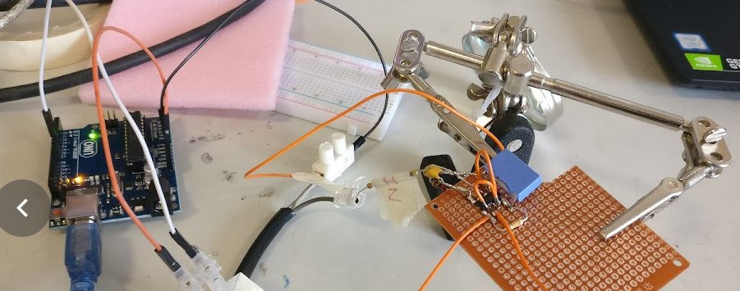
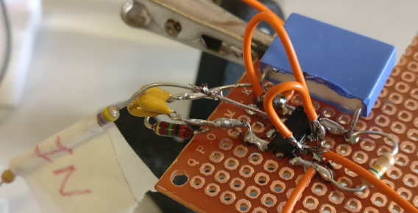
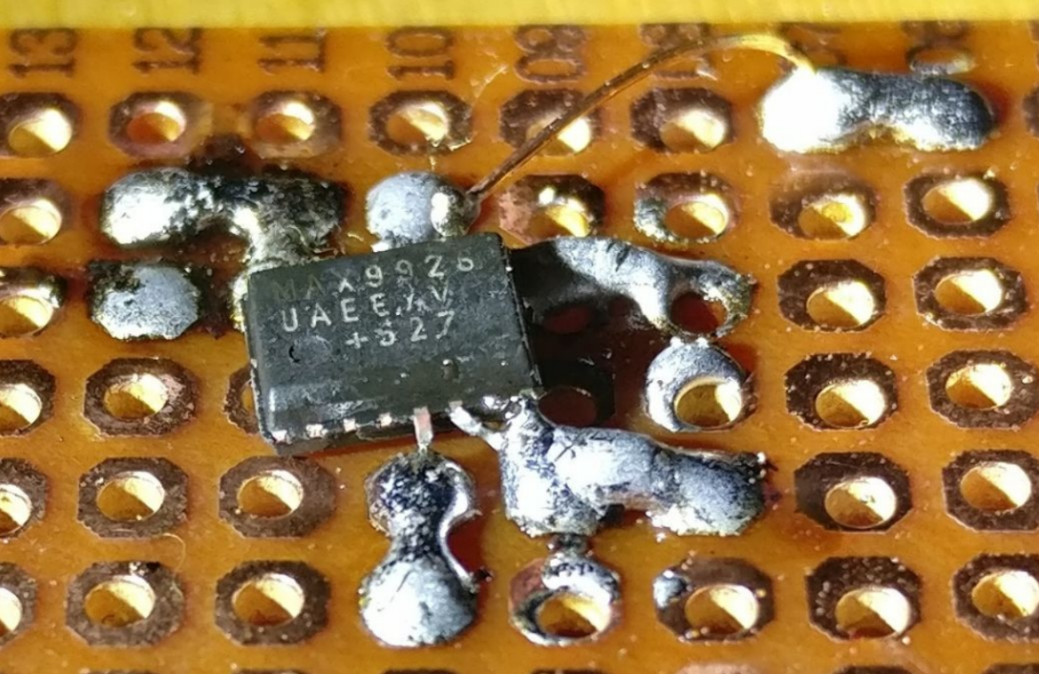
Wheel Sensorization
Validation Plan: Results
DR – Design Release
Before the manufacturing of the PCB, the circuit that converts the analog signal of the reluctor sensor into a digital signal for the microcontroller was tested with an Arduino, and afterwards with an oscilloscope. After the tests, we opted to use a MAX9926 chip instead of LM1815 for this task, because it provides a more consistent signal for very different frequencies and amplitudes.

Slide 15
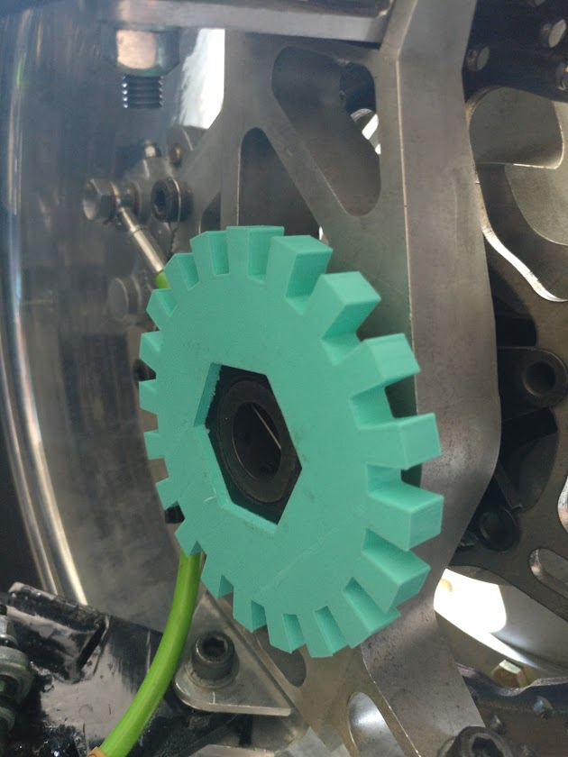
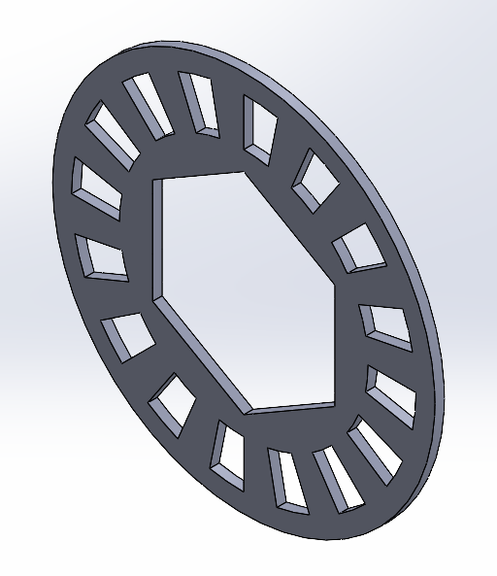
Wheel Sensorization
Validation Plan: Results
DR – Design Release
Before manufacturing the steel platen, we tested the fit with a 3d printed part.
We changed the design after realizing it was too heavy.
We calculated an amount of teeth big enough to be clearly read by the sensor, but as small as possible to have the highest precision. The frequency is not a concern for the electronics.

Slide 16
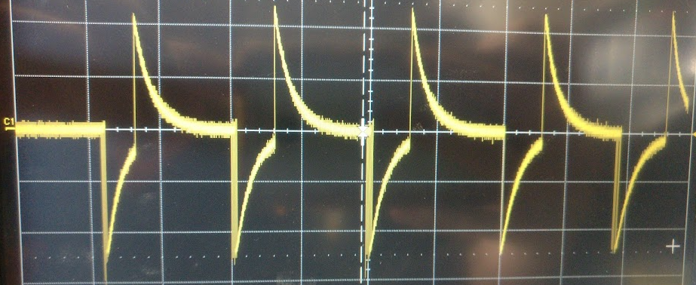
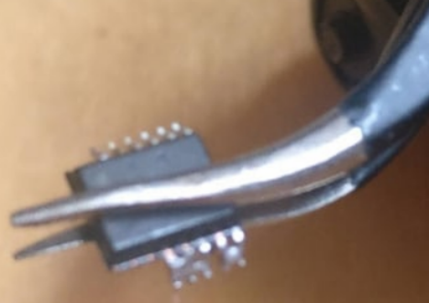
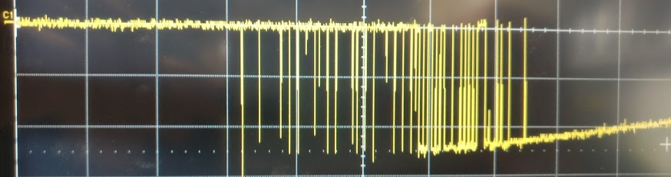
Wheel Sensorization
Validation Plan: Results
DR – Design Release
After solving some problems…

Slide 17
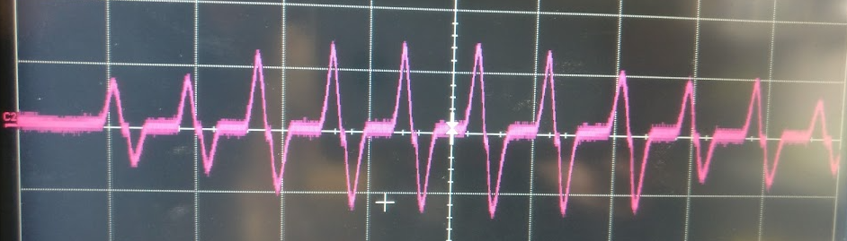
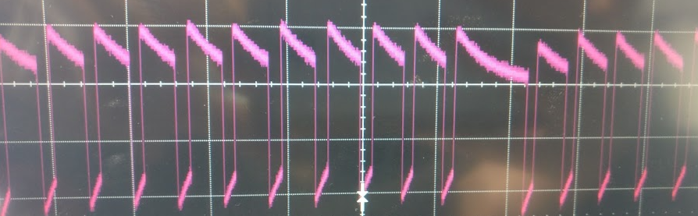
Wheel Sensorization
Validation Plan: Results
DR – Design Release
We got the following results:
Reluctor signal:
Processed digital signal, to the microcontroller:

Slide 18
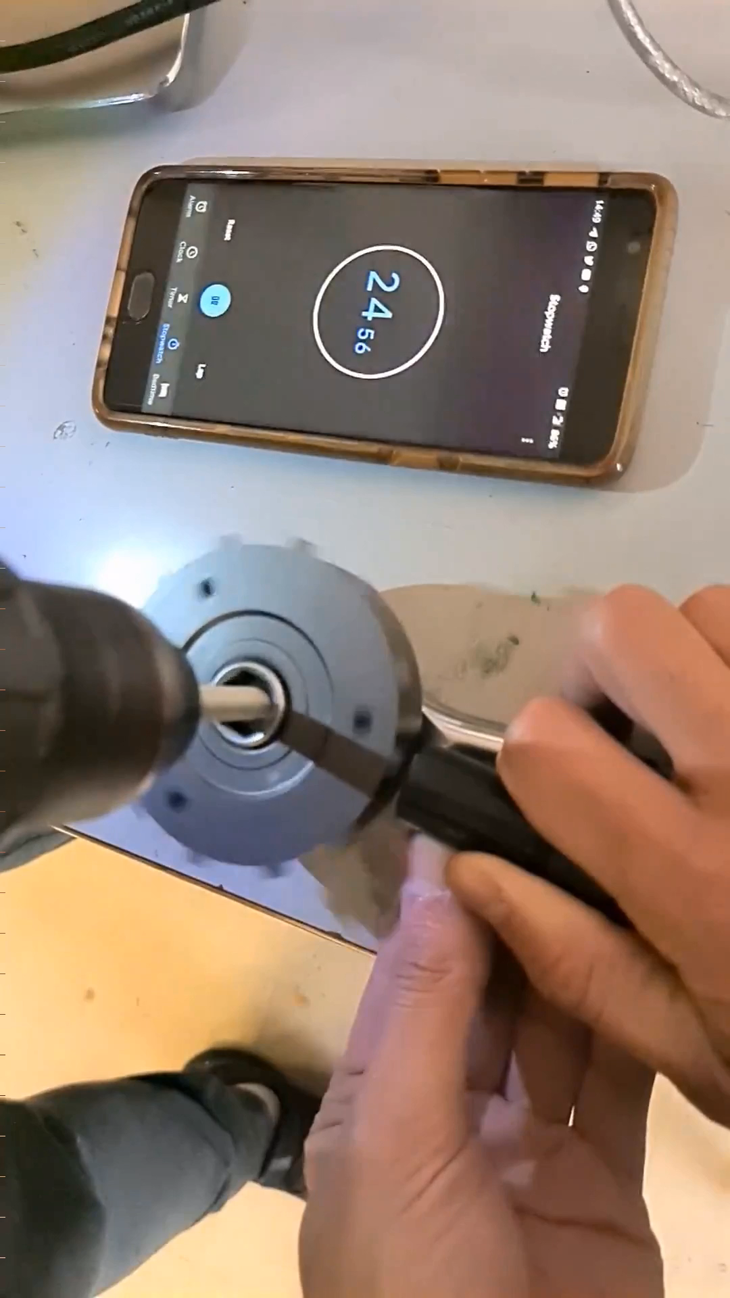
Wheel Sensorization
Validation Plan: Results
DR – Design Release
To test a correct pulse count:
We first programmed the microcontroller to count the amount of pulses and show it in the computer, then turned the wheel a specific amount of times, and compared the resulting value with the theoretical (number of rotations times teeth of the wheel). The results matched.

Slide 19
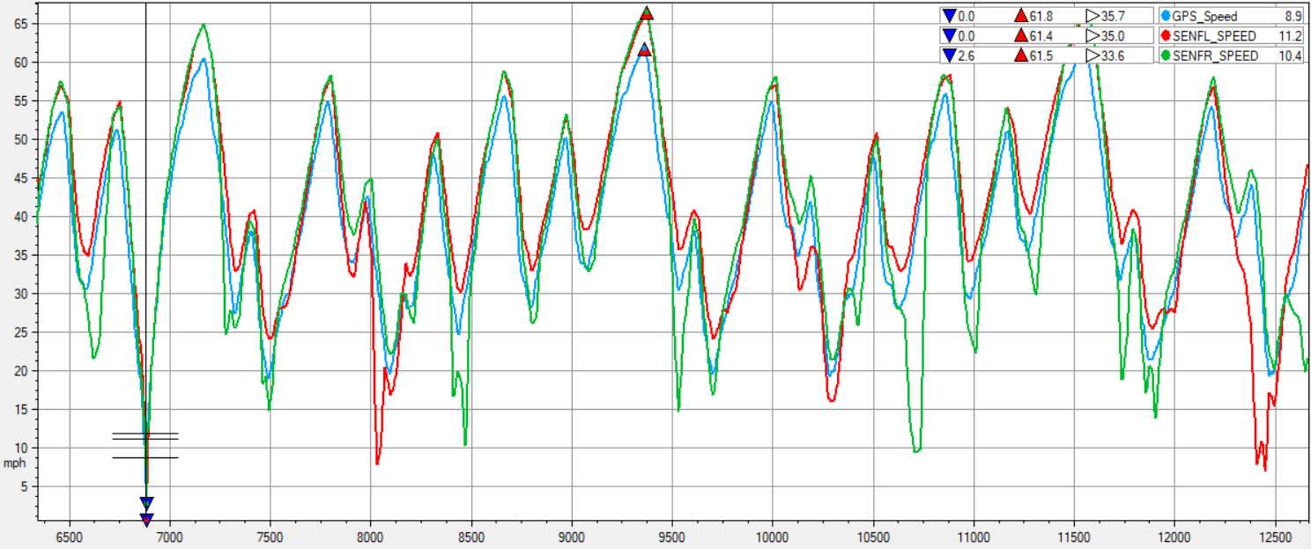
Wheel Sensorization
Validation Plan: Results
DR – Design Release
To test the full assembly: The sensor was mounted to the car, and the data recorded on a datalogger during a test run. Then the GPS speed was compared with the measured speed. The results were surprisingly similar. When the car turned left, the right wheel recorded a slightly higher speed, and vice versa. During the hardest turns, the values of the inner wheel went to zero, and we could visually check the wheel lose traction and stop spinning, while the outer wheel speed was just slightly above the GPS speed.

Slide 20
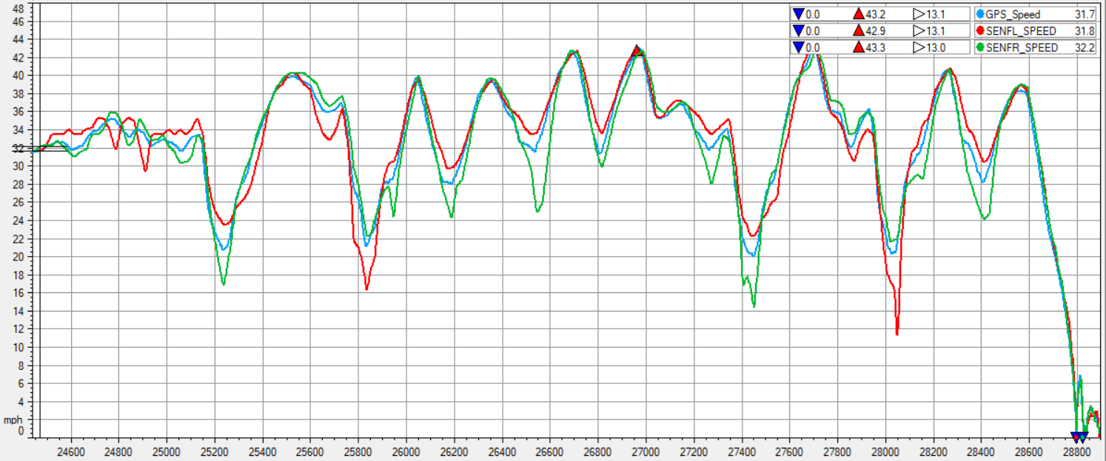
Wheel Sensorization
Validation Plan: Results
DR – Design Release
Zero-speed when stopped: When the car is stopped, the vibration of the motor sometimes makes the reluctor sensor create a high-frequency small-amplitude signal, which is occasionally recorded as short pulses of >200km/h values. This will have to be filtered via software or a low-pass filter on the reluctor input. This is not a safety concern, since the car will only think it’s moving faster than reality, and it only happens when stopped.

Slide 21
Wheel Sensorization
Market offers
DR – Design Release
JLCPCB sponsors us with a discounted price for PCBs
MOUSER is the cheapest option for common SMD components, PIC18 microprocessors, and MX connectors
RS has been our provider for reluctor sensors
The rest has been manufactured in the workshop.
Help from the university for laser cutting the steel platen
3d printing from team members’ personal printers

Slide 22
Wheel Sensorization
Targets verification
DR – Design Release
The design has been validated, but the weight can be reduced in the future design.
For the next iterations, we plan to reduce the size of the PCB, remove the steel platen with the new integrated steering knuckle, and design an integrated phonic wheel and brake disc.
The PCB can be reduced in size with a smaller 0603 package, removing some input signals, replacing the buck dc-dc converter with linear regulators, because the power consumption is extremely low (~0.5W), which will allow to make the box an estimated 4 times smaller in volume.
Item | Weight (grams) | Estimated future weight (grams)
Phonic wheel | 43 | 10
Wheel Speed Sensor | 70 | 70
3d printed box | 30 | 12
PCB + components + cabling | 40 | 20
Steel platen | 170 | ~0 (integrated into suspension knuckle)
TOTAL weight of assembly | 353 | 112
This results in a 70% estimated weight reduction.

Slide 23


Wheel Sensorization
Updated documents
DR – Design Release
Document | Name | ¿Affected?
SE3D | Structural equivalency 3D Model
IAD | Impact Attenuator Data
SES | Structural Equivalency Spreadsheet
SESA | Structural Equivalency Spreadsheet Approval
FTO | Fuel Type Order
CRD | Cost Report Documents
BOM + CBOM | Bill of Materials
CEF | Cost Explanation File (Part of CRD)
SM | Supporting Material (Part of CRD)
EDR | Engineering Design Report
DSS | Design Spec Sheet
BPES | Business Plan Executive Summary
ASF | Autonomous System Form
ADR | Autonomous Design Report

